Slide 1

Beyond the Pool:
What High School Coaches Need to Know

Slide 2
New to Coaching High School?
Coaching high school an entirely different list of expectations from coaching a club team or a summer league team.
The information presented in this presentation will guide you through the many tasks that await you as a high school coach.
Don’t become overwhelmed. Don’t be anxious. Relax and enjoy the experience. Coaching high school can be one of the most rewarding experiences you can have.

Slide 3
At the end of this presentation you should be able to:
Identify state and school requirements
Organize yourself to handle all of the tasks to be completed
Create a framework for a Team Handbook
Determine what training you may need to provide for team leaders, assistant coaches, and managers
Prepare for a Parent/Athlete pre-season meeting
Create a plan for the season
Create evaluation materials to evaluate your season and yourself

Slide 4

Some helpful advice: Be ORGANIZED.
It will save you many headaches.
Plan ahead. You can never be too organized.
Anticipate any potential challenges.
Be certain of your responsibilities.
Be aware of the school administration’s expectations.
Pay attention to details.

Slide 5

Divide and Conquer
To insure that tasks are not overlooked and are completed on time, you might consider dividing them up into categories.
You might divided them into:
School, Swimmer, Parent
Guidelines, Schedules, Paperwork
Pre-season, In-season, Post-season

Slide 6
Once you have divided the tasks into categories, you can further divide them by grouping similar tasks together.
For example: Paperwork, Meet Management, Equipment, etc.

Slide 7
Self-directed Assignment #1
Determine a method to divide the season’s tasks.
Write the categories down or enter them into your computer.
Add tasks to each category as you move through the season.
An example you might use follows.

Slide 8
Pre-season

Slide 9
Pre-season Paperwork
School and District Level
Meet schedule
Coach or Athletic Director made?
Transportation Forms
Bus? Vans? Personal cars?
Passengers?
Additional forms for out-of-town or overnight?
Who Schedules transportation?
Academically Eligible?
Most schools and state organizations have academic requirements.
Physicals?
Many state organizations require a physical before 1st day of practice
Weather restrictions for practice
There may be restrictions even for indoor practices
Additional Paperwork may include:
Substance Abuse Policies
Pool Schedule/Reservations
Fundraising Forms
Schedules for Team Pictures, Team Dinners, Senior Banners, etc.
Communication with local club coaches about shared athletes and training

Slide 10

Pre-season Paperwork
Program Specific
Team Handbook – PUT IT IN WRITING
  Coaching philosophy
  Team rules and regulations
  Coach’s expectations
  Tryout Criteria
  Lettering Policy
  Attendance Policy
  Practice and Meet Schedules
  Booster Club Responsibilities

Slide 11

Self-directed Assignment #2
Create a list of items to include in a Team Handbook.
As you proceed through this presentation, add to your list of items to be included.

Slide 12
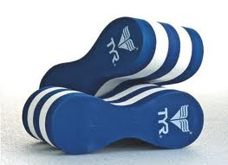

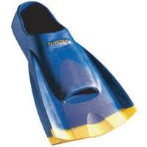
Pre-season Tasks
Equipment, Uniforms and Technology
Learn the meet and entry software
Learn how to set up the timing system and check to make sure it is operational
Check stopwatches and replace batteries as needed
Inventory equipment and uniforms
Order new equipment and uniforms as needed
Update or create a team website

Slide 13

Pre-season Tasks
Staff, Officials, and Team Leaders
Secure your coaching staff and provide any training needed
Schedule officials for home meets (you might need to update them on rules changes for the year)
Meet with the leaders of team and provide leadership training as needed
Select team managers and provided necessary training

Slide 14

Pre-season Tasks
Rules and Regulations
Obtain a NFHS rulebook and read it
Become familiar with the specific regulations of your State Association concerning numbers of meets, state meet entries, state meet qualifications, etc.

Slide 15

Pre-season Tasks
Parent/Athlete Meeting
Schedule a meeting with the parents, swimmers and divers prior to the season.
Discuss the Team Handbook, if you prepare one.
Discuss expectations concerning attendance, sportsmanship, academics, the lettering policy, the requirements to make the team, practice and meet schedules, ways for parents to help, booster club responsibilities, district and school forms (including physicals)

Slide 16
Self-directed Assignment #3
Gather the materials necessary for a pre-season meeting with parents and athletes.
Determine how you will present the material.

Slide 17
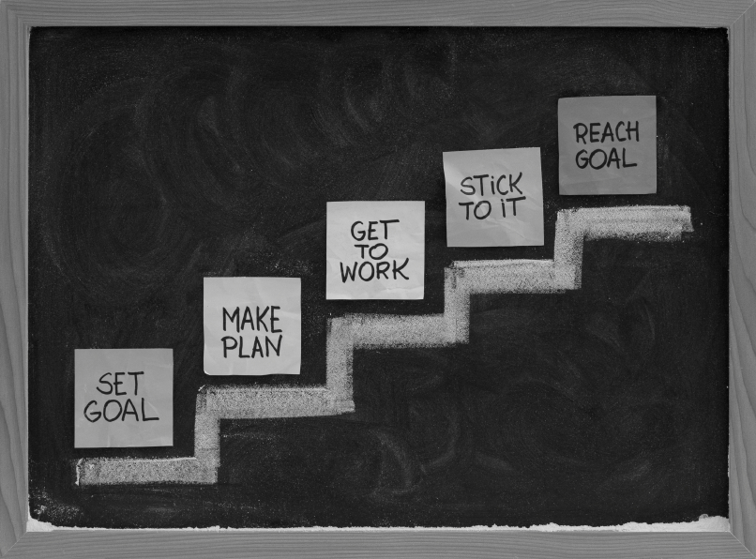

Season Planning
Prepare a season plan for all aspects of training: dryland/weights program, training, goal setting and psychological training, and a teambuilding program.

Slide 18
Self-directed Assignment #4
Create a Season Plan
Include all aspects of the program

Slide 19
In-season

Slide 20

In-season Paperwork
Daily attendance, if your policy requires such
Dismissal from class e-mails
Announcements for meet results, team accomplishments, etc.
Meet entries
Meet information for home meets
Heat sheets for home meets and other meet reports
Team roster, once determined
Order forms
Maintain records dealing with meet results, school records, lettering
Obtain USA Swimming sanctions for championship meets

Slide 21
In-season Tasks
Confirm transportation schedule
Communicate daily with your staff and provide training as needed
Communicate with team managers on a daily basis about their responsibilities
Prepare meet entries
Set up pool equipment to host meets
Maintain equipment
Confirm schedule for officials
Maintain communication with the parent booster club
Train officials to run the timing system.

Slide 22
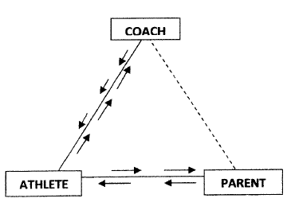
A Few Notes About In-season Communication
Establish and maintain good communication with the divers and your diving coach.
Establish and maintain good communication with your parent booster club.
Keep your Athletic Director and his Administrative Assistant informed about what is happening with your program.

Slide 23
An Important Tip
Develop a good relationship and keep good lines of communication open with other coaches and sponsors in your school.
Be flexible with student expectations.

Slide 24

Make the Administrative Assistant and Custodians your friends. Treat them as equals. It pays off.
Establish good communication with the person in charge of student recognition and student announcements.
Know the office staff and custodians by name. They can be a great help to you throughout the season.

Slide 25
The College Recruitment Process
Meet with appropriate swimmers and their parents concerning the college recruitment process
Write e-mails or letters to college coaches, when appropriate
Be knowledgeable about the Clearing House and NCAA rules and regulations

Slide 26
Tips for Hosting a High School Meet
Learn how to set up the timing system.
Test the system before the first meet.
Teach your managers and/or swimmers how to set up and take down the equipment.
Assign tasks to various groups of swimmers.
  Example: Juniors and Seniors – timing system Freshmen and Sophomores – chairs
Train your managers how to run the software to hold your meet. If an official is late or absent a manager can assist.
Allow plenty of time to set up the pool area for meets.
You might arrange for cheerleaders or National Honor Society members to serve as timers for the meet.

Slide 27
Self-directed Assignment # 5
Create a list of things to do in order to host your home swimming meets.
Make the list clear enough that anyone could pick it up and use it to set up a meet.

Slide 28
Post-season

Slide 29

Post-Season Paperwork
List of names who earned athletic letters to AD or AD’s secretary
Banquet program
NISCA Power Points application
NISCA Swimming and Diving All-America applications
NISCA Scholar Team application
NISCA Academic All-America applications
Prepare season summary including All-State, All-Conference, All-America swimmers and divers for AD

Slide 30
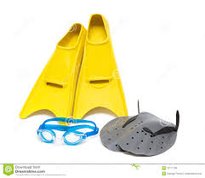
Post-Season Tasks
Collect equipment and uniforms from athletes
Make sure equipment is securely stored away
Prepare inventory list for AD and yourself
Determine any needed repairs and submit list to the AD

Slide 31

Evaluations
Meet with your coaching staff to evaluate their performances and to give them an opportunity to offer their suggestions and concerns.
Meet with your AD to discuss your coach’s evaluation.
Assist swimmers and divers in their recruitment endeavors.

Slide 32

Evaluate the season’s schedule and begin to prepare next year’s schedule
Evaluate the team’s performance for the season and determine what changes you, as a coach, need to make to your season plan.

Slide 33
Self-directed Assignment #6
Consider how you will evaluate your program and yourself at the end of the season.
Create a framework for your evaluation.

Slide 34

Personal preparations for the next year
Continue your professional education during the post-season. Be a student of the sport.
READ – RESEARCH– LISTEN – ASK QUESTIONS
Join your professional organizations.

